Slide 1
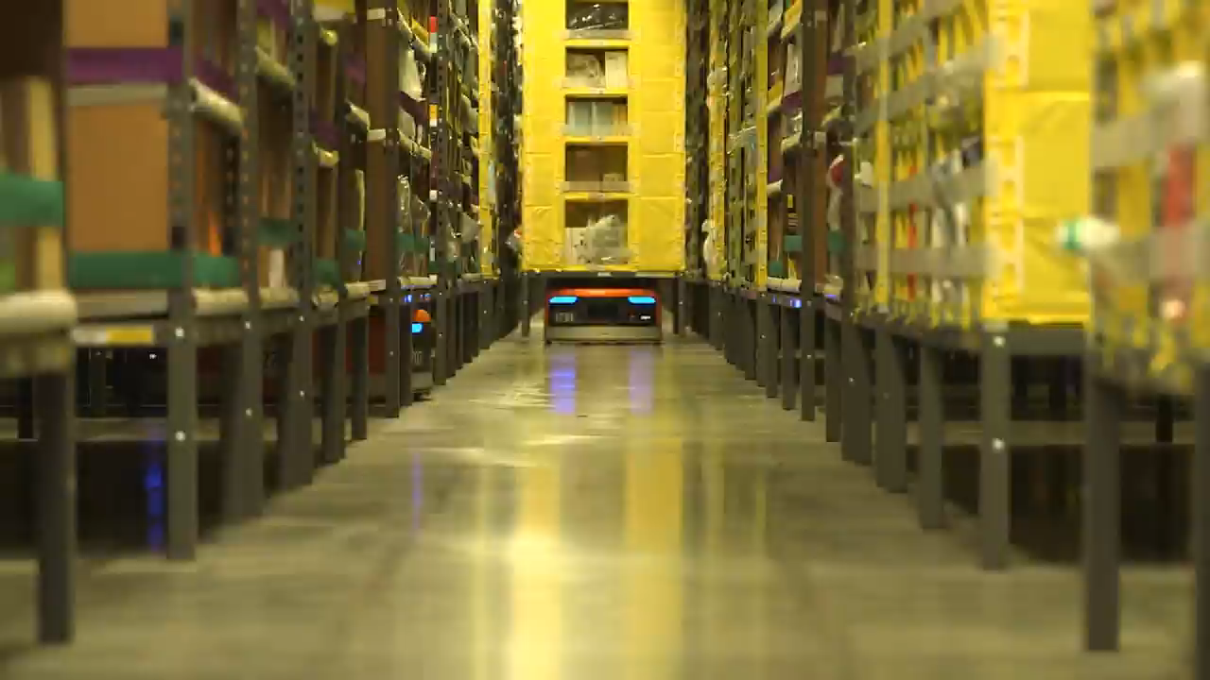

Slide 2
Artificial Intelligence V.S
Human
Chenman Song 宋沉蔓 2016216105
Ruize Han 韩瑞泽 2016216085
Dongxu Miao 缪东旭 2016218041
Chen Cui 崔晨 2016216078

Slide 3
Chen Cui

Slide 4
Will we lose our job?
Will artificial intelligence make human unemployed?

Slide 5
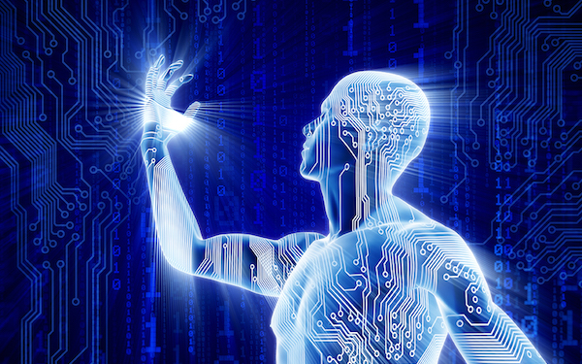
Artificial Intelligence
The answer is yes.

Slide 6
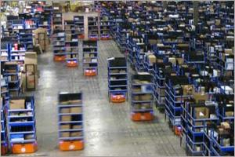
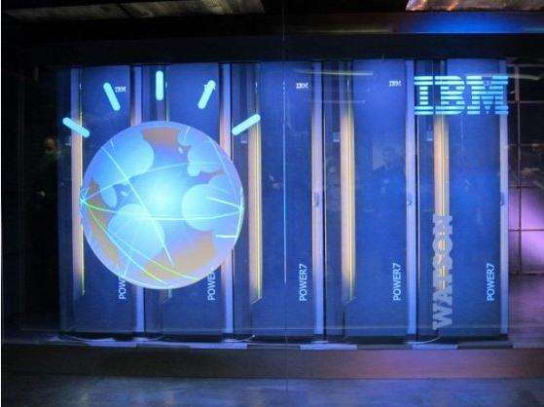
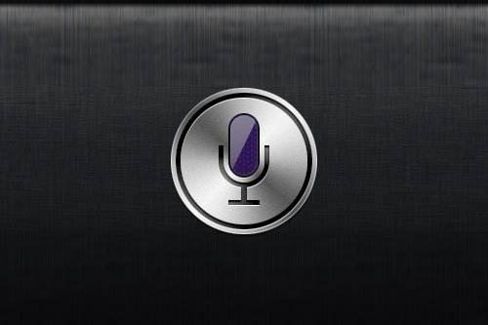
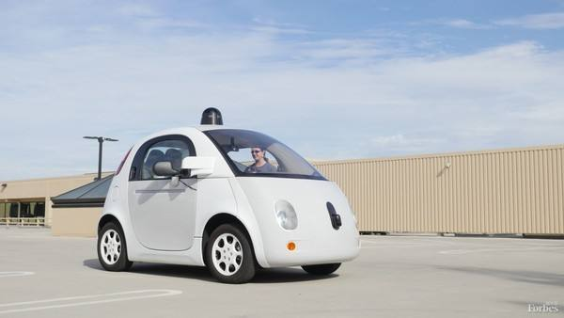
The application of artificial intelligence
Kiva intelligent warehousing system
Watson Supercomputer
Siri voice assistant
self-driving Google car

Slide 7
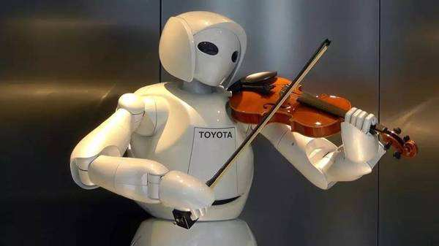
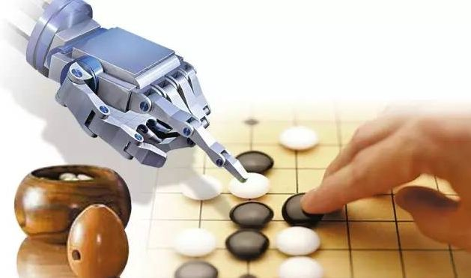
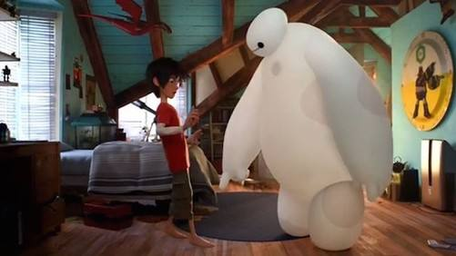
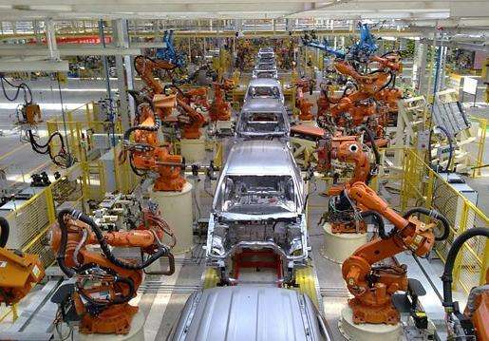
The application of artificial intelligence

Slide 8
Are you afraid of it?

Slide 9
Chenman Song

Slide 10
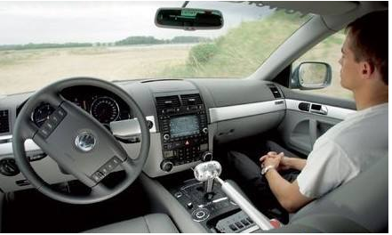
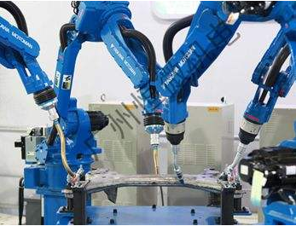
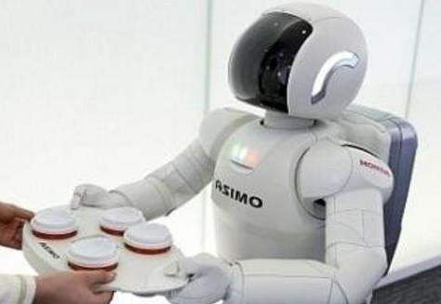
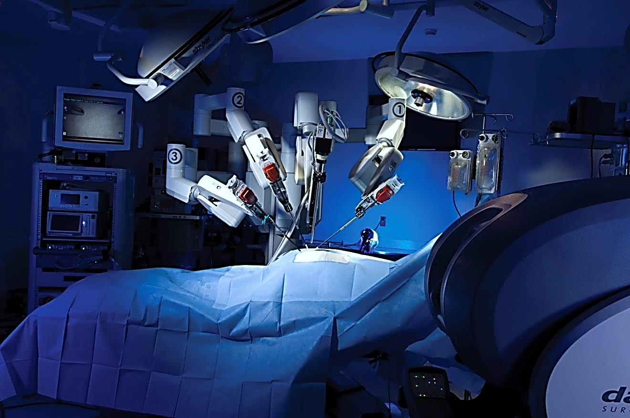
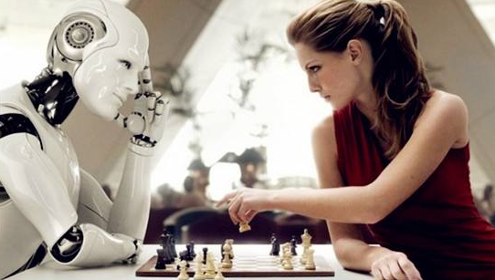
AI

Slide 11
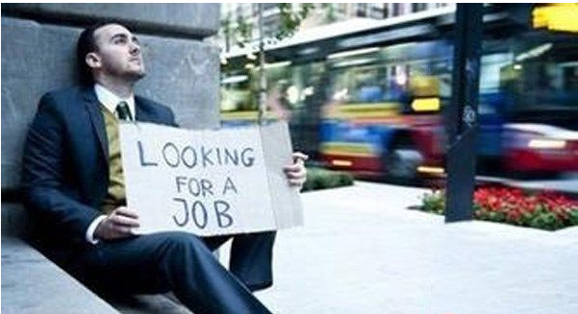
Will that be true?

Slide 12

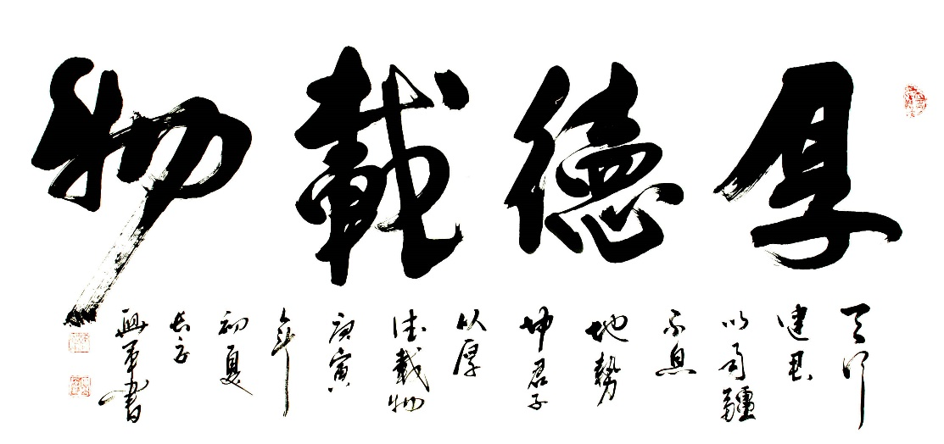
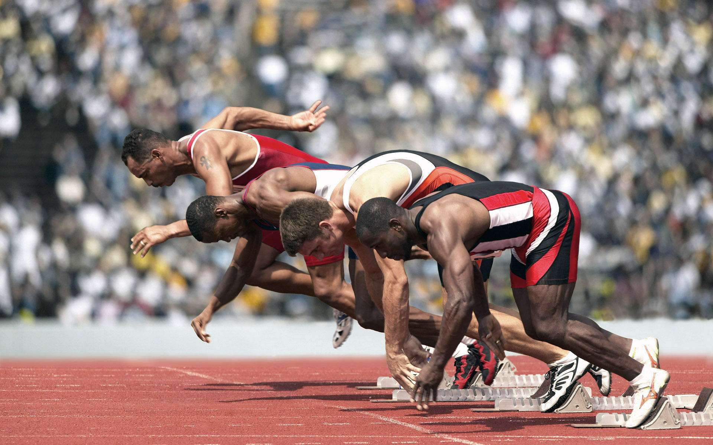


Slide 13
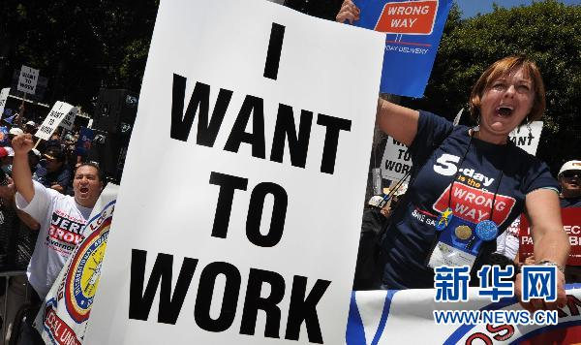
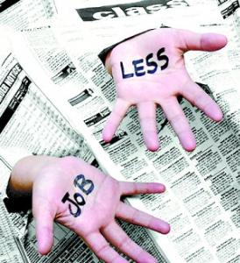
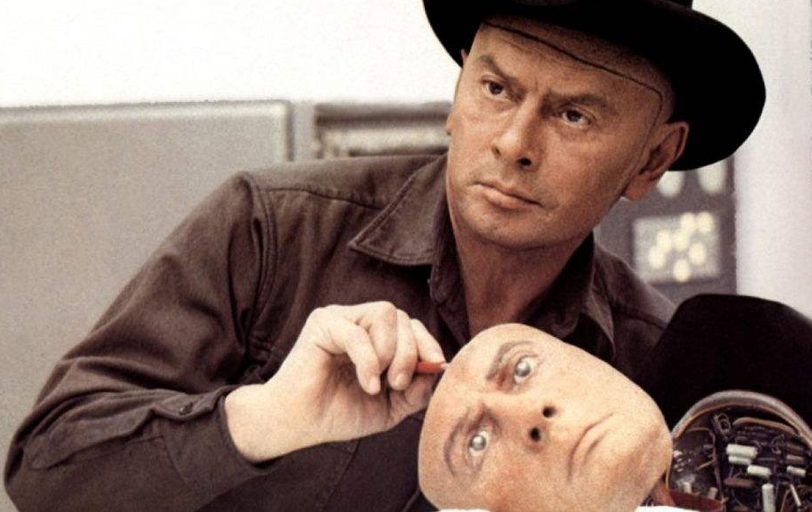
Human and Intelligent Robots

Slide 14
Ruize Han

Slide 15
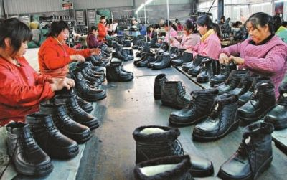
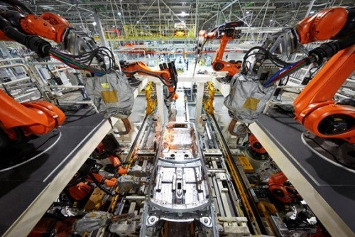
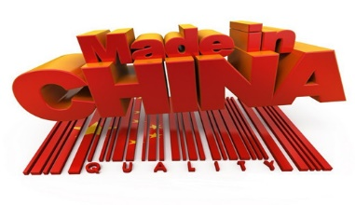
In the past
Today

Slide 16

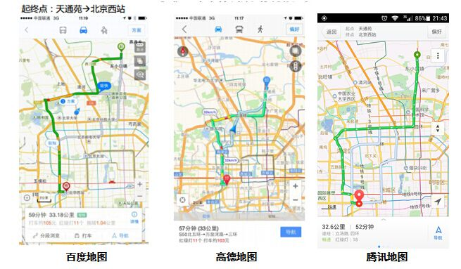


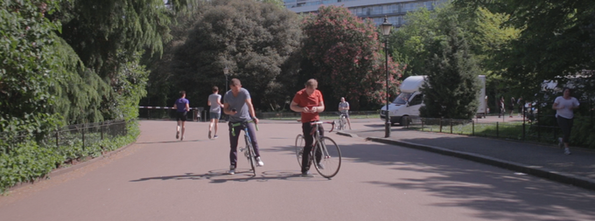
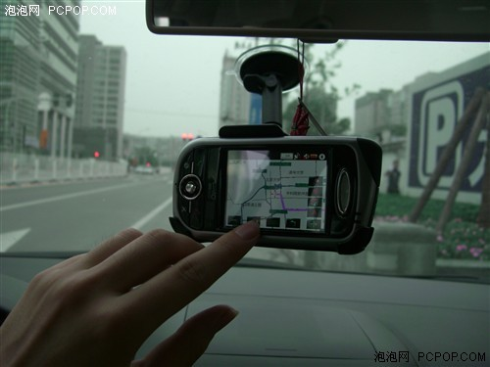
In the past
Today

Slide 17
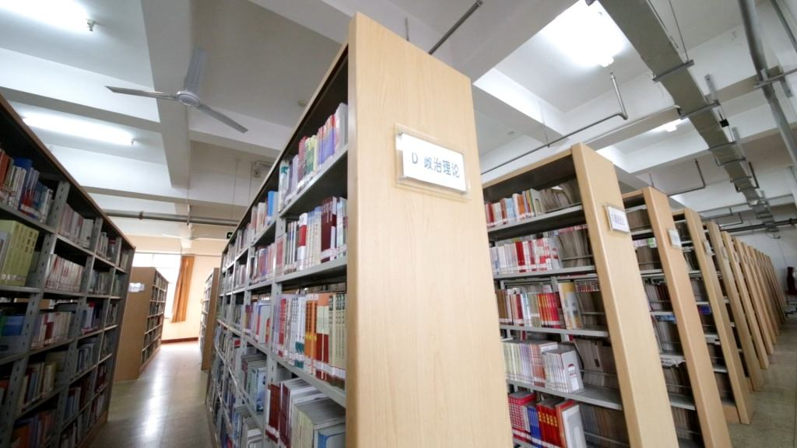
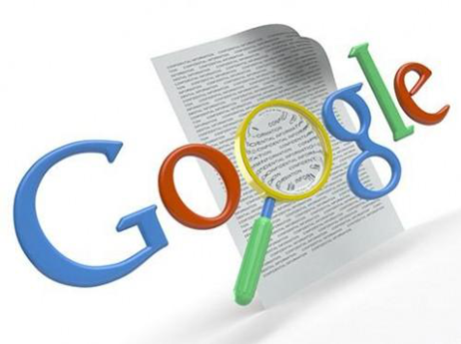
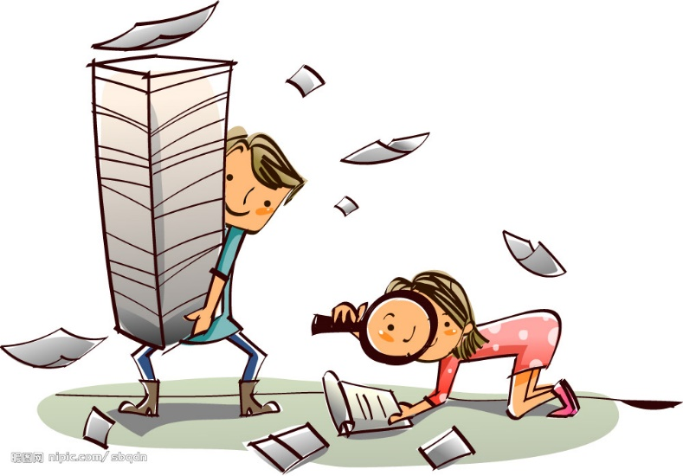

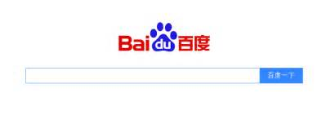
In the past
Today

Slide 18
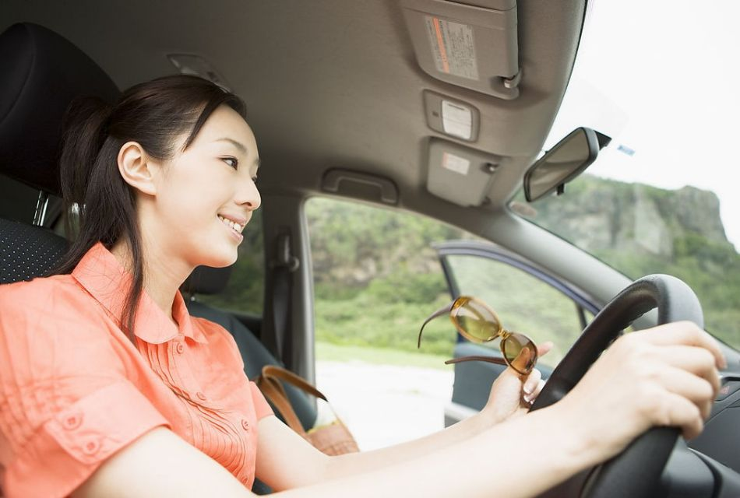
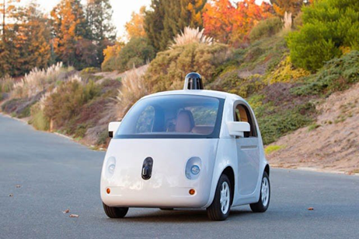
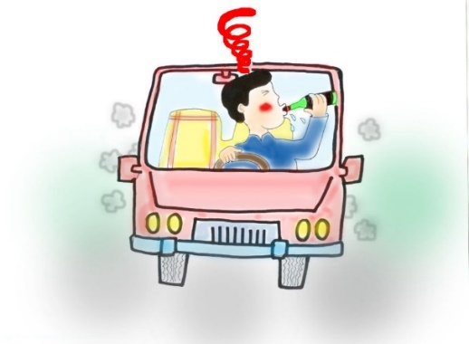
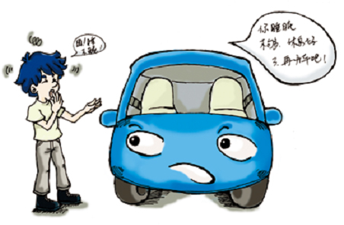
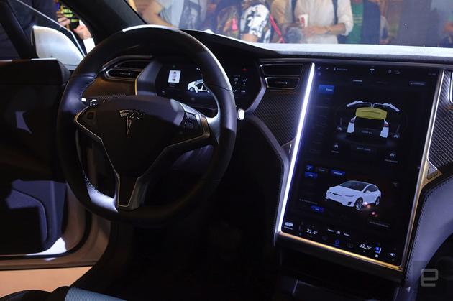
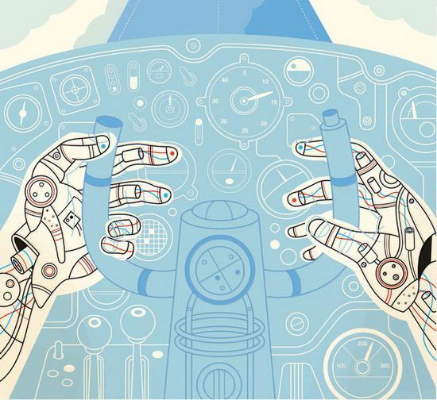
Today
In the future

Slide 19
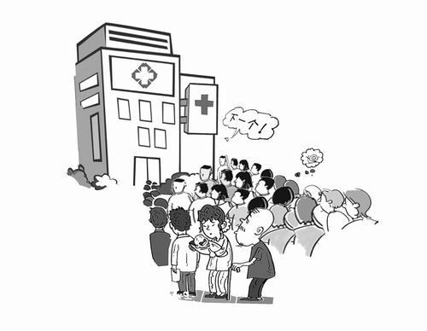
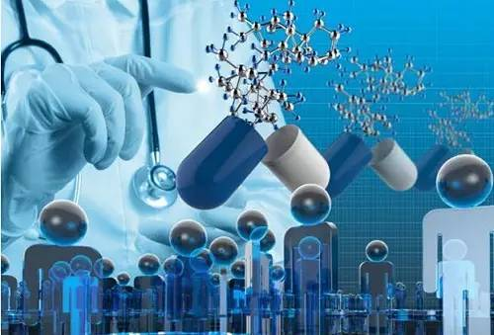
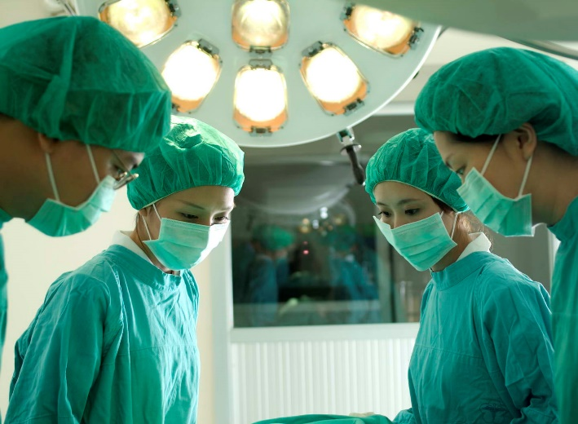
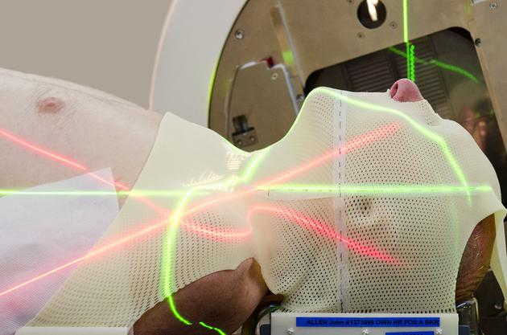
Today
In the future

Slide 20
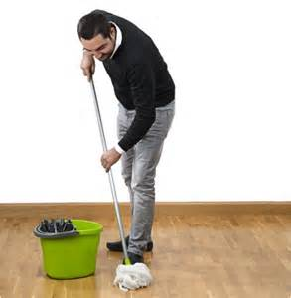
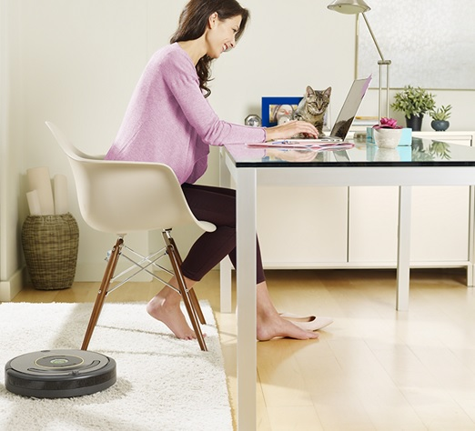

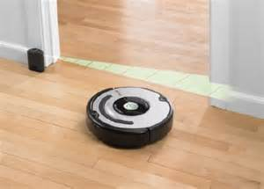

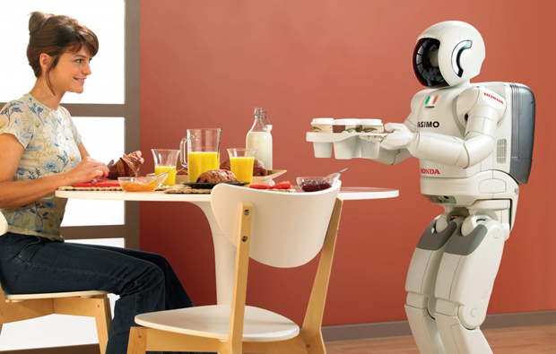
Today
In the future

Slide 21
Dongxu Miao

Slide 22
Every technological revolution take over someing, but bring more.

Slide 23
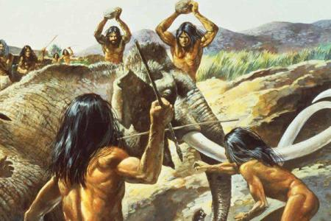
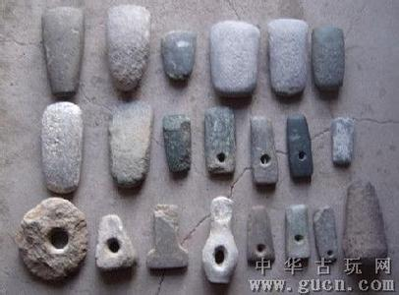
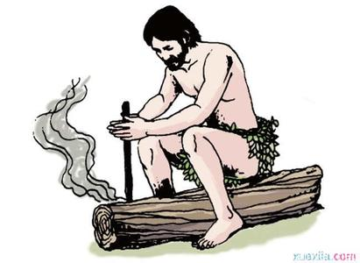
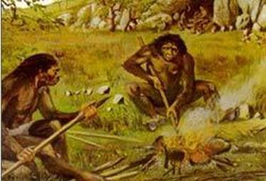
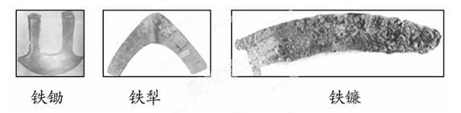
Technological revolution -- fire

Slide 24







Technological revolution -- steam engine & combustion engine

Slide 25






Technological revolution -- electric power

Slide 26





Technological revolution -- AI

Slide 27
Free Debate

Slide 28







Slide 29









Slide 30
Conclusion

Slide 31
Will AI make human unemployed?
Yeap
Nope
The technology of AI will be more and more mature and applied to more fields.
For many jobs, AI will do equal to or better than human.
With lots of work completed by AI, human will have more time to do things interesting and enjoy the life.
The technology of AI is not always correct，how to solve the problem caused by AI is controversial.
In some emotional and creative works, AI cannot replace human.
The technology of AI will create lots of new jobs when it actually replace some one.

Slide 32




THANKS
Chenman Song 宋沉蔓 2016216105
Ruize Han 韩瑞泽 2016216085
Dongxu Miao 缪东旭 2016218041
Chen Cui 崔晨 2016216078

